Slide 1
M-RENT MANAGEMENT SYSTEM
NAME: MURAYA MARY WANGARI
REG.NO: 16/01200
NAME OF SUPERVISOR: MR.FRED OMONDI
FACULTY: FOCIM
COURSE: BACHELORS IN BUSSINESS INFORMATION TECHNOLOGY
UNIT:FINAL YEAR PROJECT
UNIT CODE: KCA 398

Slide 2
INTRODUCTION
The purpose of m-rent management system is to manage the rents of various houses in m-agency in order to track all the rents paid every month. currently it is done manually.
The main function of the system is to store tenant details including rent and retrieve this detail when required.
System input includes tenant details, landlord’s details, caretaker details and the agency details, amount of rent to be paid on each house and the output will display on the screen.
M-rent management system can be logged in using a username and password. It will be accessible by an administrator. only the administrator can add data into the database.
M-rent will make it easy for landlords, property managers, and real estate owners to manage properties, bill tenant and collect rent from their tenants.
The system will be able to enter tenant payments, emailing statements and documents, viewing tenant notes, highlighting any tenant for tracking purposes, moving tenants in or out, and printing daily bank deposit slips.

Slide 3
BACKGROUND
M-rent management system will provide quality service in real estate management. The system will be established with the aim of managing estates for both commercial and individual houses. The vast majority of medium and large real estate agencies in Kenya barely use computer systems in the management of their property and information relating to renting of houses.

Slide 4
PROBLEM STATEMENT
The property manager and the management team are currently using a paper based system to track rent. The system faces the following problems
security of records. Non-authorized person can access the files. through the manual way, data is recorded on books/papers which may easily get damaged leading to loss of data.
Duplication of records. Currently all the operations are done manually and there is no database and so duplication of data is possible.
Records for the clients as well as those of the houses are kept in a manual file because there is no central computerized database. lack of these crucial requirements makes management of the tenants and houses very difficult as some tenants may end up not paying rent.
speed. The manual system is very slow and time consuming especially when one is to generate reports since one has to go through all the records.
The system is prone to manipulation because there is no particular database system and forgeries can be done by those in authority since they have all the information to their disposal and have the authority to make changes.

Slide 5
PROPOSED SOLUTION
The system shall eliminate any forgeries and manipulations of records and incase of any it can be tracked.
The records will be more secure as no unauthorized person can be able to access. The system will have a username and password.
The system will be fast as compared to the manual system where one is required to go through every file in order to find the records.
The tenant will be able to view the amount of rent to be paid and incase of any balance he or she will be notified.
The system shall reduce duplication of records as it can detect if any record exists or not.

Slide 6
PROJECT OBJECTIVES
Specific objectives
Design a system that will store tenant details, which includes the name, mobile number and the house number or house address.
Develop a reliable and easy to use system that will replace the manual system.
Implement a system that will increase efficiency and effectiveness while managing and tracking rents
The system will enable the property manager to know which house is vacant and what is the amount of rent of that particular vacant room.
General objectives
To develop a rental house management system that allows property managers and landlords to view customers data as well as houses record.
To develop a system that allows the users to add, edit, search and delete data from the database
To generate annual reports on rent payment by the tenants.
To achieve data integrity, and uniformity, by defining data types and constraints in a database that would hold all the data.

Slide 7
PROJECT JUSTIFICATION
The significant of the system is to ensure that there will be effective management of m-rent records and will keep all information up to date.
The system will ensure Improved data storage: this will be because of central database where all information can be accessed at any time.
Confidentiality: this will be achieved through the use of usernames and passwords where only authorized personal can access data and information.
Efficiency: efficient data analysis will be realized to facilitate easy decision making for example if the tenant is recorded to having debts, then he or she will not be able to access some services e.g. water.
Reduced fire risk: incase of any fire the files can be easily be retrieved.

Slide 8
PROJECT SCOPE
Project scope defines the description of the work that is required in delivering the rental house management system. M-rent management system will be designed to help perform core functions which wills includes:
Tenant registration: -clients will be able to register and update their details online as long as there have access to the internet.
Billing statements: -the system will provides a module that generates billing statements, statements of account and delinquent statements in order to effectively manage rent billings. an accounts receivable module also records rent payments received and keeps a running total of the total amount of rent billed less the total amount paid.
Property accounting: -property management system helps rental property managers with the financial aspects of their business.
Tenant & lease tracking: -the system allows rental property manager to automate and track the leasing process from beginning to end. this application enables tenant screening, automatic rent collections and vacancy planning.

Slide 9
LITERATURE REVIEW
INTRODUCTION
The m-rent management system refers to an ongoing process of managing the records in a neutral media basis in accordance with approved policies of the housing industry. real estate as a discipline defines and applies business rules related to the creation, protection, retrieval and deposition of a property rent schedules are the corner stone of a successful rent management system process. “there cannot be a rent management system without rent and neither can there be rent efficient record keeping without a good management system (toussaint 2015).
Some of the dominant strategies for housing and service provision for the kenyan urban poor including the slum upgrading and site and service schemes. however, the efficiency of these strategies has been limited by ambivalent government attitude to irregular settlement. the government initiates in assisting house owners in management have proven to be slow with many of the houses being economically and socially irrelevant (macloo,1994)

Slide 10
Case study of the existing RENTAL management system
E-kodi management system
E- kodi is a kenyan startup located in jubilee building, nairobi readying for full launch, planning to shake up the real estate market with its property listing and management platform. E-kodi provide a property listings site for rentals and sales, the startup goes a step further by providing a full suite of management services to streamline the rental process. it gives agents a listing site to get tenants, and a management dashboard to manage the tenancy.
The system is not user friendly as the design of the user interface is the key element(cornel 2015). This has necessitated the management to incur excess cost in training the new user. Also, searching for tenant information is a challenge as the system they are using cannot provide that option. The system can’t generate receipt which forced the management to use manual system.
kodisher property management system
It is an online solution for property managers and landlords of every size to manage financials, tenants and maintenance. it is easy to use, affordable and integrated with mobile money payment methods. kodisher links your rent collection, equity bank account or your safaricom mpesa paybill number to automate tenant payment reconciliation. kodisher property management system helps property managers organize financials, payment and receipts and reduce cost in managing tenants and landlords.
The system is not friendly to people who are not computer litrate. There is also a lot of manipulation and forgeries by those in authority.

Slide 11
BENEFITS OF RENTAL MANAGEMENT SYSTEM
The system greatly simplifies the record of the rent management system by offering outline services.
As a source of information recordkeeping can be seen as a strategic resource for m-rent management system. kasim (2011:171) affirms that information can be viewed from the resource based view of the firm in accordance with strategic management theory. Basically, this perspective suggests that resources are vital for organizational success.
The implication for rent management systems is that information in the form of business records need to be properly managed in order to survive in their fiercely competitive business environment. This means that good record management can be used by the properties as a strategic resource to improve business performance.
Under the rent restriction tribunal act chapter 296 of the laws of kenya, the tenants may be classified as service tenants since they are all civil servants and the landlord being the government. The meager earnings of these tenants compound this problem hence provision of essential services is left unchecked.

Slide 12
METHODOLOGY
RESEARCH METHODOLOGY
questionnaires
This will be achieved by using a document that contains a number of questions to selected people so as to collect information about the system.
Interviewing
The aim of the interview is to obtain information from the landlord and the tenants where each of them has to be asked questions face to face. it will ensure capturing of their facial expression that they will use in explaining the challenges they face in the using the manual. the answers given will help me in developing the system.
observation
Done to bring out the requirement from the practical point of view. most of the problems were observed during the research.
document review
This includes reviewing the existing system documentation to understand how the system works.

Slide 13
DEVELOPMENT METHODOLOGY
Spiral Lifecycle Model
The spiral model also known as the spiral lifecycle model, is a system development lifecycle model used in information technology. It combines the features of the prototyping model and the waterfall model. uses incremental development, with the aim of managing risk. In the spiral model, developers define and implement features in order of decreasing priority. An initial version of the system is developed, and then repetitively modified based on input received from customer evaluations. The development of each version of the system is carefully designed using the steps involved in the waterfall model. With each iteration around the spiral (beginning at the center and working outward), progressively more complete versions of the system are built.
The spiral model relies heavily on prototyping. when using prototyping, the developer builds a simplified version of the proposed system and presents it to the customer for consideration as part of the development process. The customer in turn provides feedback to the developer, who goes back to refine the system requirements to incorporate the additional information.

Slide 14
STEPS IN SPIRAL
project objectives
Similar to the system conception phase of the waterfall model. objectives are determined, possible obstacles are identified and alternative approaches are weighed.
Risk assessment
Possible alternatives are examined by the developer, and associated risks/problems are identified. resolutions of the risks are evaluated and weighed in the consideration of project continuation. sometimes prototyping is used to clarify needs.
Engineering & production
Detailed requirements are determined and the software piece is developed.
Planning and management
The customer is given an opportunity to analyze the result of the version created in the engineering step and to offer feedback to the developer.

Slide 15
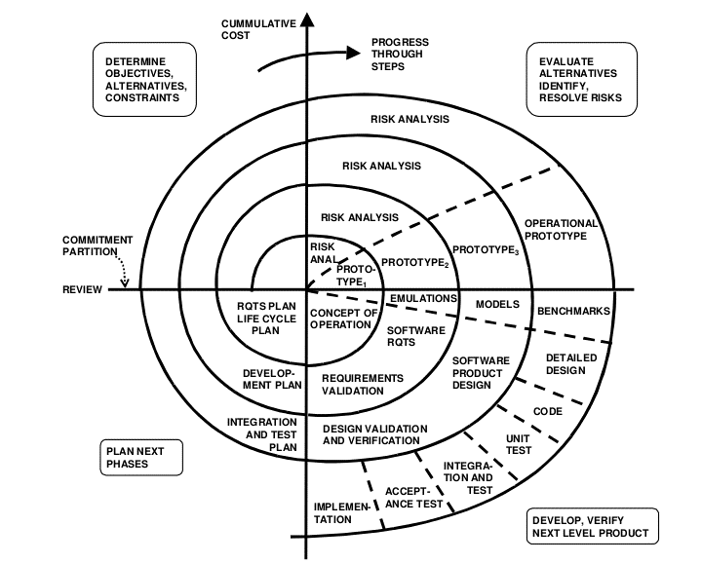
SPIRAL MODEL

Slide 16
ADVANTAGES OF SPIRAL
Change can be introduced later in the life cycle.
Project monitoring is very easy and effective. each phase requires a review from concerned people. this makes the model more transparent.
Risk management is one of the inbuilt features of the model, which makes it extra attractive compared to other models.
DISADVANTAGES OF SPIRAL
Skills required. it needs expertise. i have some skills in it and i could ask for help from my colleagues in school.
Rules and protocols should be addressed properly to effectively implement this model. i will follow all the rules in order to implement the model in an effective way.

Slide 17
PROJECT BUDGET
Item | Description | Quantity | Estimated Cost | Actual Cost
Hardware Laptop Printer Hard disk | HP 1 Terabit | 1 1 1 | Available 20,000 Available | Available 18,000 Available
Software
Antivirus | Kaspersky |  | Available | Available
Stationary Pens Printing papers Miscellaneous | Rim Single Rule | 1 1 2 1 | 800 200 800 10,000 | 500 100 1000 8000
Total |  |  | 31,800 | 27,600

Slide 18
PROJECT SCHEDULE
Task no | Description | Task no. of hours | Subtask no. of hours | Planned start date | Actual start date | Planned completion date | Actual completion date | Deliverables
1 | Proposal document | 72 | 30 | 24/09/2019 | 25/09/2019 | 28/09/2019 | 28/09/2019 | project proposal
2 | Proposal presentation | 1 | 1 | 1/10/2019 |  | 1/10/2019
3 | Requirement analysis | 120 | 30 | 3/10/2019 |  | 17/10/2019
4 | Design | 480 | 60 | 1/11/2019 |  | 15/11/2019
5 | Coding | 130 | 35 | 21/11/2019 |  | 4/12/2019
6 | Testing | 750 | 100 | 2/1/2020 |  | 15/1/2020
7 | System presentation | 1 | 1 | 6/3/2020 |  | 13/3/2020

Slide 19
RESOURCES
software | stationery | Hardware
NET BEANS | Printing papers | Computer-intel CORE i-5
MY SQL | Ball pens | Printer
Note Pad | Note books | Storage device-Hard disk
 | pencils

Slide 20
CONSTRAINTS OF THE SYSTEM
Cost
The individual cost of development may be high coupled with lack of adequate resources that need to be purchased for the completion of the system
Time
The main hinderance from time would be completion of the system in the specified duration which is short however it is still achievable with good time planning
Resources
The consideration for resources such as the machine (laptop), stationery, printing and binding services that will be used during the project.

Slide 21
Reference
Rent restriction act chapter 296, laws of kenya
The landlord and tenant act of 1985.
https://disrupt-africa.com/2017/05/kenyan-property-management-platform-e-kodi-set-for-launch/

